Slide 1
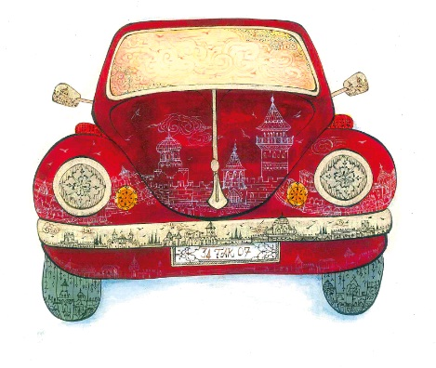
REJUVENATING TRADITIONAL ARTS
CASE OF ISMEK
Kerem KÖKER
Deputy General Coordinator
August 2014

Slide 2
Introduction
Video of Istanbul and ISMEK
What is İSMEK?
İSMEK & Traditional Arts
Conclusion

Slide 3
Kerem KÖKER
BSc, Computer Engineering - BSU - Tukey
Art Appreciation Class - 2nd Year 1 Term
BSc, Mathematics and Computer Sciences – BSU - Turkey
MSc,Management, Economics and Industrial Engineering – Politecnico di Milano – Italy
2011 - Present, Deputy General Coordinator of ISMEK
Responsibilities : Foreign Relations, Business Development, Sales and Job Placement
ISMEK Video Link
Introduction →

Slide 4
İSMEK -İstanbul Metropolitan Municipality Art and Vocational Training Courses-, provides art and vocational education to İstanbullians since 1996.
İSMEK is an “adult education organization” and one of the largests of the globe.
What is İSMEK?

Slide 5
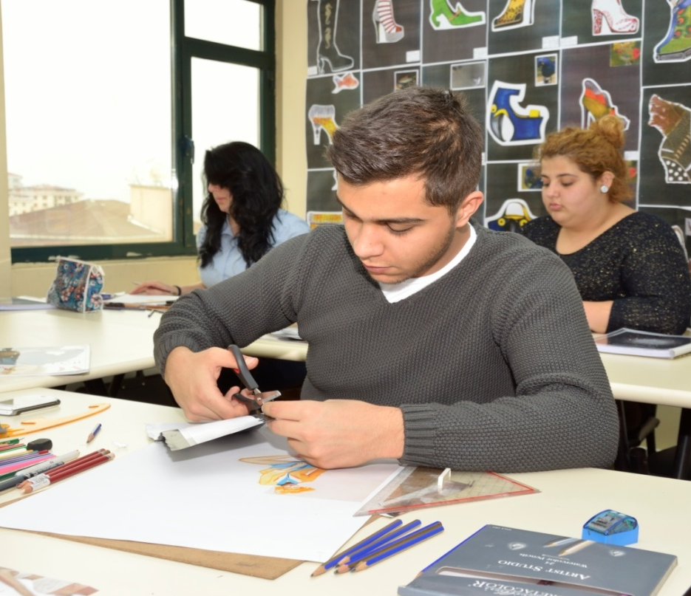
Financials
All training programmes, within the scope of İSMEK are free of charge for trainees.
Expenditures are met by
İstanbul Metropolitan Municipality
Approx. 100.000.000 TL
What is İSMEK?

Slide 6
Figures - Trainees
Number of trainees that get education from İSMEK since its foundation has exceeded from 141 to 1.830.000.
This year alone, İSMEK has reached 230.000 new trainees.
Total applications to İSMEK has reached
2 .500.000 up to now.
What is İSMEK?

Slide 7
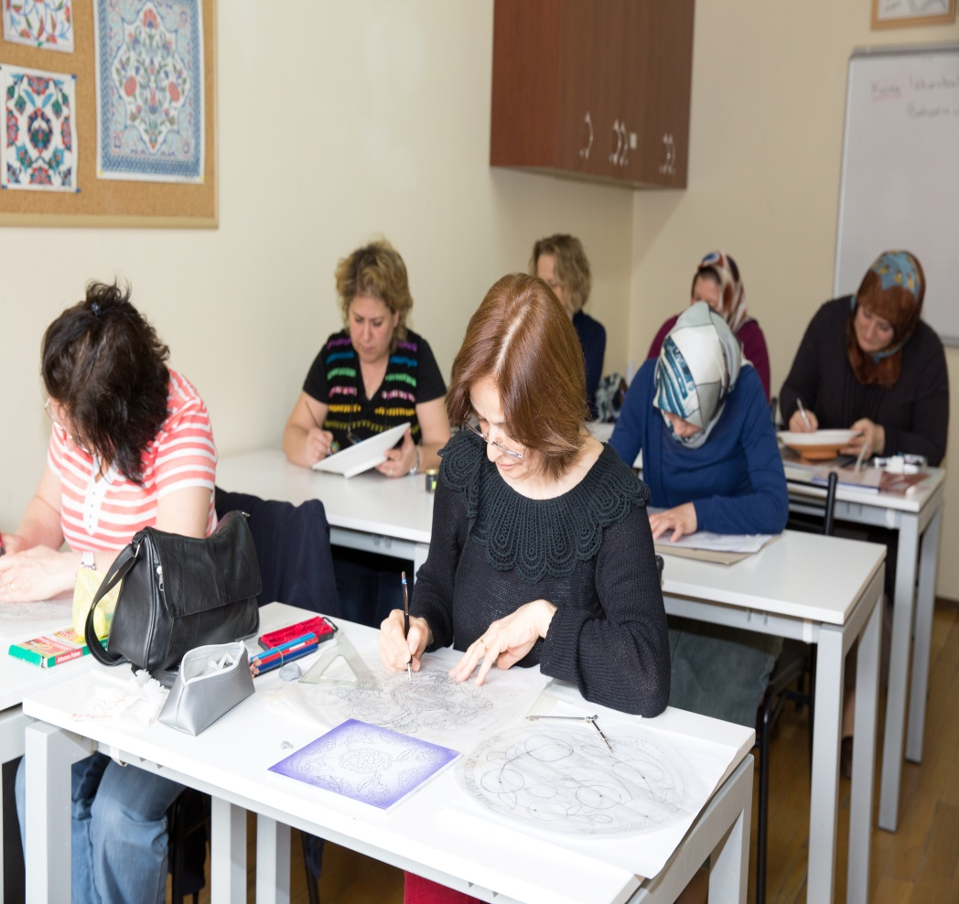
Figures - Course Centers&Employees
Out of 39 districts of Greater Metropolitan Area of İstanbul İSMEK has 242 course centers in 38 districts. There are also point of sales in 2 most crowded districts and a Management Center.
Current number of employees is around 3200 and 2500 of this number is expert artists and vocational trainers/teachers.
What is İSMEK?

Slide 8
Demographics of Trainees
What is İSMEK?

Slide 9
Number of Fields of Trainings
“VOC + Art”
Currently there are 250 fields of education
What is İSMEK?

Slide 10
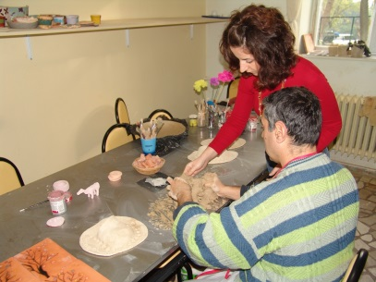
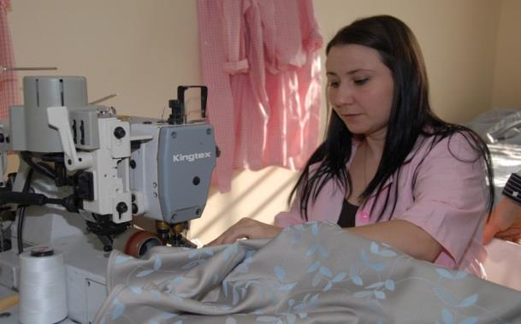
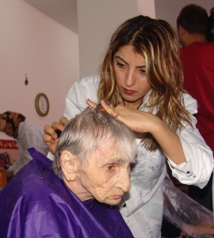
DISADVANTAGEOUS GROUPS
4
HOSPITALS AND REHABILITATION CENTERS
7 PENAL INSTITUTIONS
2
NURSING HOME
and ALMS HOUSE
3 DISABLED EDUCATION CENTERS
What is İSMEK?

Slide 11
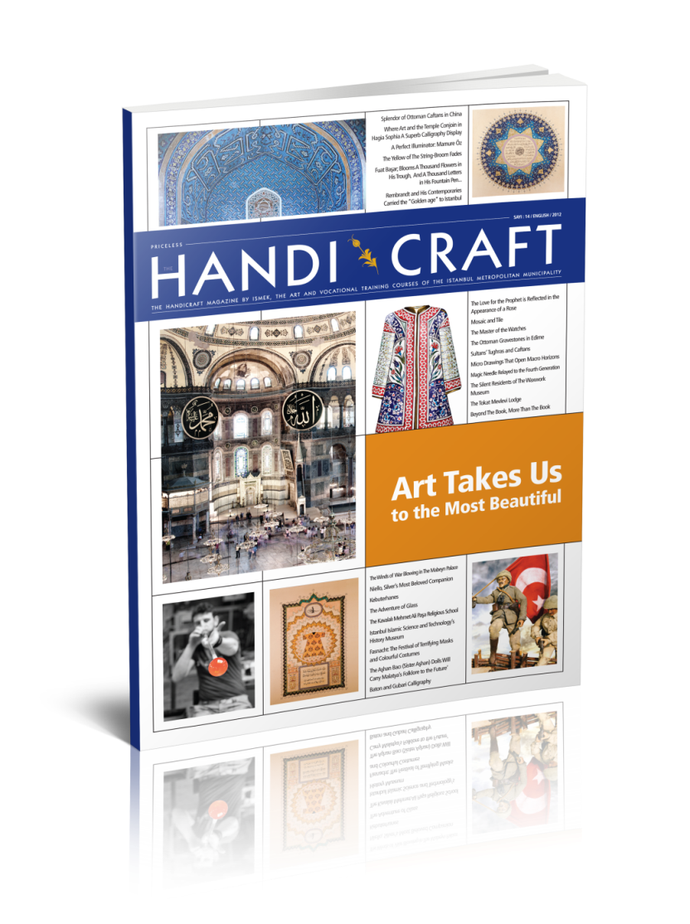
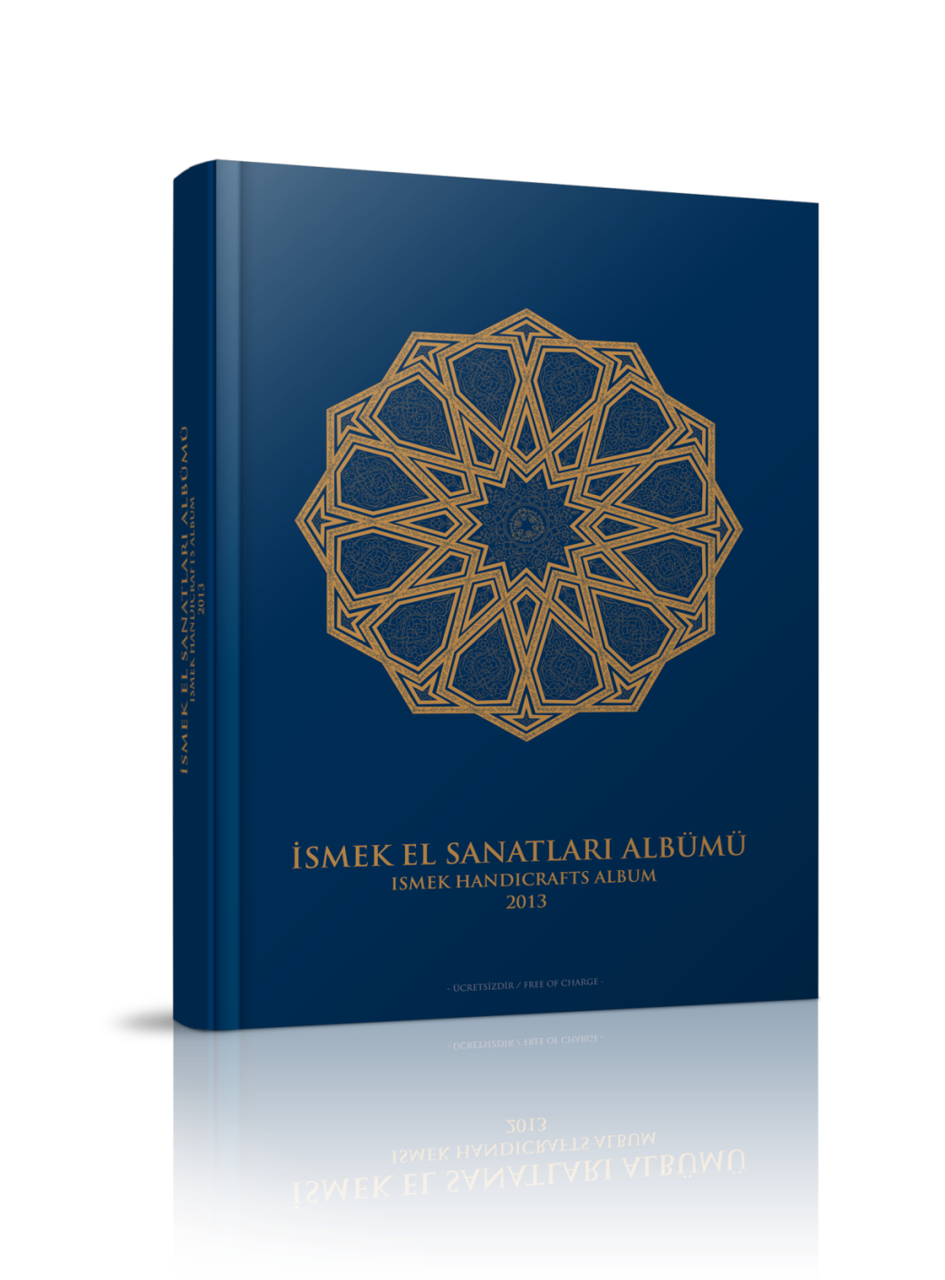
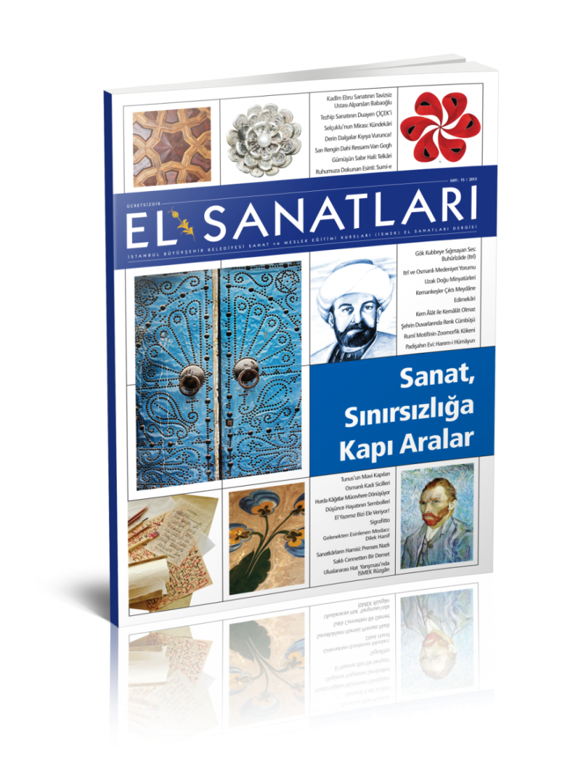
Art Publications
*İSMEK stands out with its free Arts&Crafts publications.
What is İSMEK?

Slide 12
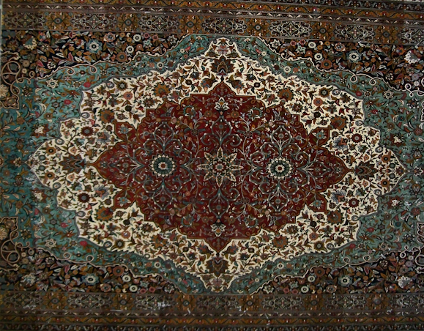
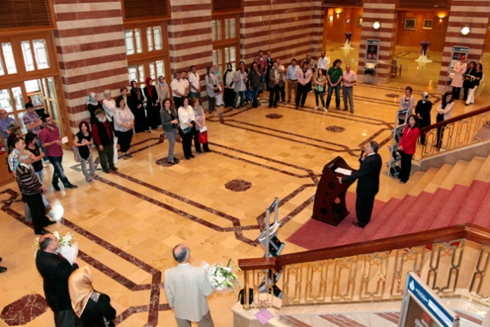
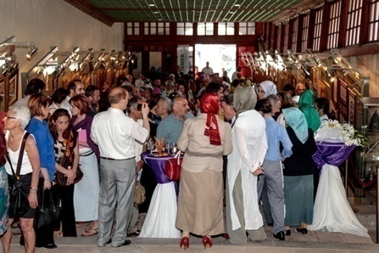
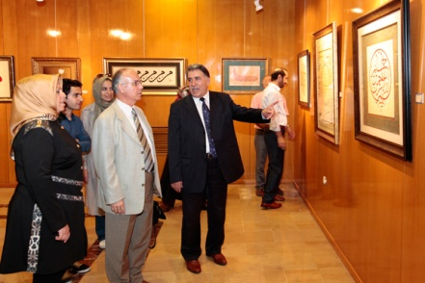
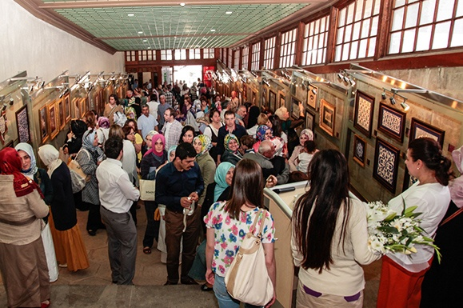
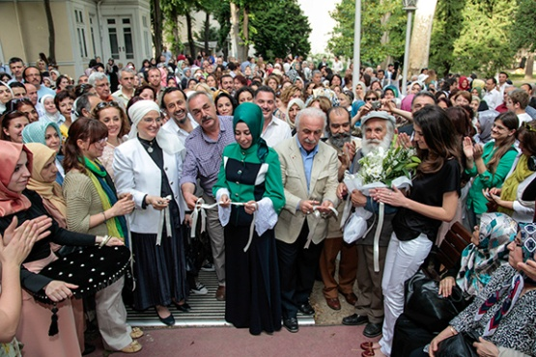
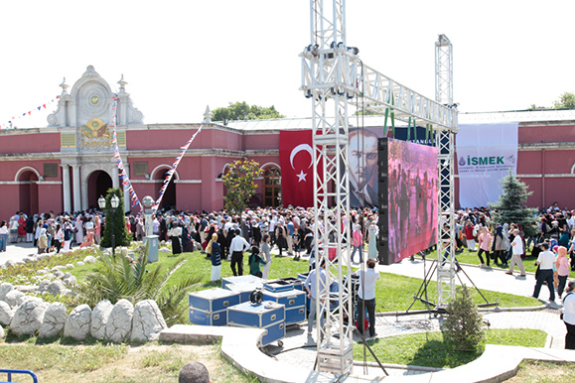
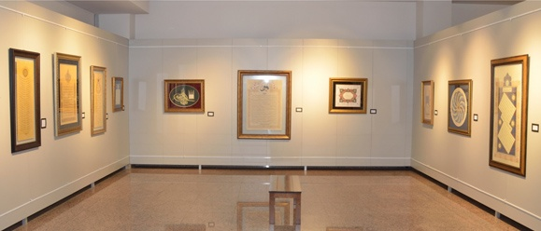
Exhibitions&Sales
What is İSMEK?

Slide 13
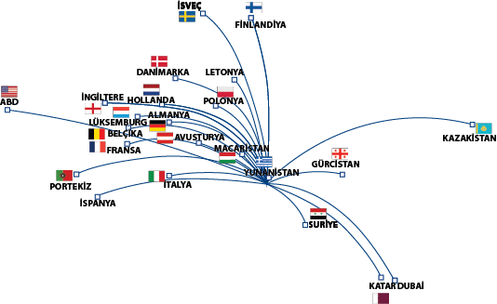
International Exhibitions and Fairs
ToTs – For OIC Countries
Intenational Cooperations - Pojects
Study Visits for Trainers & Artists
What is İSMEK?

Slide 14
Purposes of İSMEK
What is İSMEK? →

Slide 15
How ISMEK Contribute Regeneration of Traditional Arts
Sustainability&Commitment
Design and create an ecosystem
Democratize
Popularize
Stick to tradtion but leave space for creativity
Get art into the daily life of society
Show the gold to the new artists
Survival and Quality of Life
Possibility
Market
Attractivity
Functionality
*Never take your hands off!
*This is a continuos process
ISMEK & Tradional Arts/Crafts
Notes:
Design and begin to create an ecosystem
Democratize
Popularize
While sticking to tradition, leave some space for creativity of new generation
Show the gold

Slide 16
Experienced Artists/Masters
Short term poject
Students
?
Re/Co/Creating An Ecosystem
?
?
?
ISMEK & Tradional Arts/Crafts

Slide 17
Re/Co/Creating An Ecosystem
Artists/Masters
Students willing to learn an art
An art literate society
Good source of funds
Affordable and reachable materials/Suppliers
Media to talk about arts continuosly
Convinced authorities to support forever – This feelings must inherite to future authoties as well
Exhibitions and Galleries to accept student’s works as well
Sales Channels – Even small amounts of income out of art works can be a real good motivator
Buyers/Market
…
Without full support and at least stakeholders to provide everything above continuosly not possible at all to create an Ecosystem which is crucial..
?
?
?
?
ISMEK & Tradional Arts/Crafts

Slide 18
3 Steps
Democratization
Art for people
Anybody can learn first come first served
Popularization
Create Art Literates
The gold!
Point of Sales
Free of charge
Just in front of your doorstep an İsmek Center
Exhibitons in different districts/countries
Shows
Competitions
Entrepreneurship
Online sales
Job placement, etc.
Media Coverage
Adult education centers
Occasional Sales Events
Etc.
ISMEK & Tradional Arts/Crafts

Slide 19
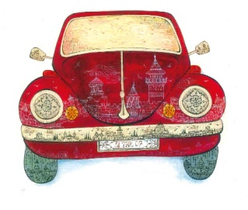
What we have learnt in ISMEK?
Traditional Arts are mostly not familiar to the people!
Ecosystem is the only way!
Never forget the red car!
All affords to regenerate traditional arts will be successful only if you do not rush the things.
Never stop, it will definitely be slower than expected.
This is a not ending marathon, so instead of thinking on it get your hands in!!!
Conclusion
Notes:
Most probably young minded creativity will break the rules of tradition of the arts, get ready!

Slide 20
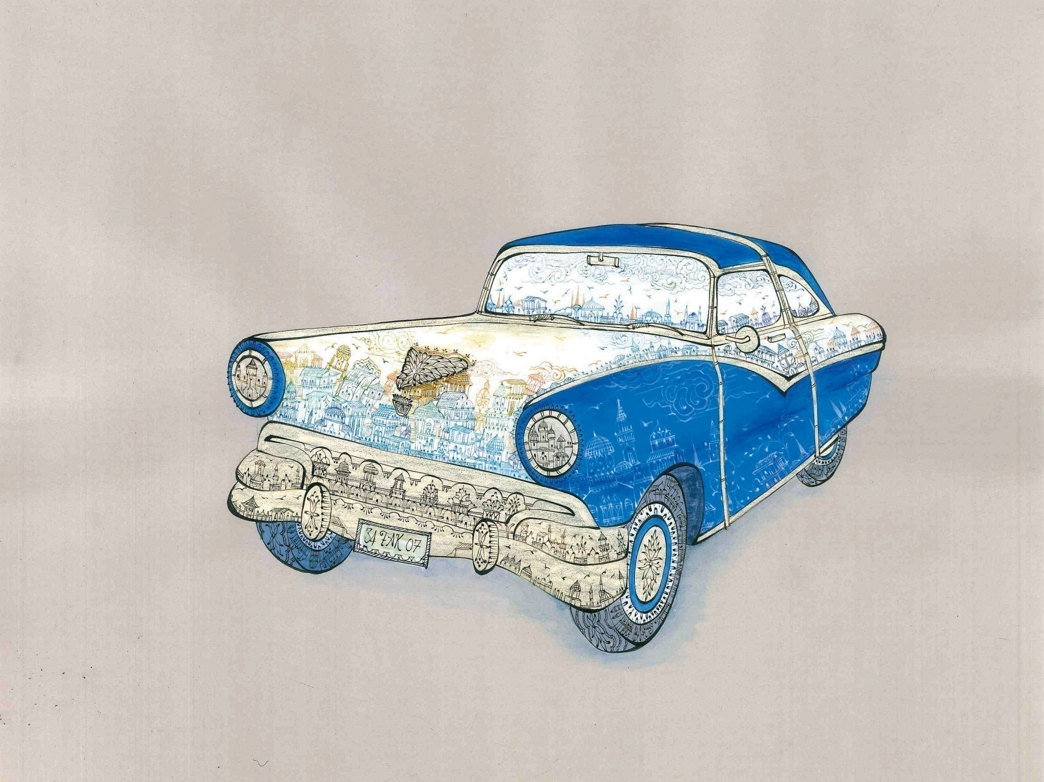
Thank you!

Slide 21
Kerem KÖKER
Deputy General Coordinator
M: +905323106293
keremkoker@ismek.org
www.ismek.org
Communication

